Slide 1
Best practices: Async vs Coroutines
Dmitriy Chebanov

Slide 2
О спикере
В разработке 8+ лет
Ментор в DevSauna
Руковожу командой разработки XR продуктов
LinkedIn
dima-chebanov
Telegram
DmitrySx
GitHub
ChebanovDD

Slide 3
Почему эта тема?
Практически никто не использует async/await

Slide 4
Практически никто не использует
Avoid using async and await
The Unity API is not thread safe and therefore, you should not use async and await tasks. Async tasks often allocate objects when invoked, which might cause performance issues if you overuse them.

Slide 5
Практически никто не использует
Avoid using async and await
The Unity API is not thread safe and therefore, you should not use async and await tasks. Async tasks often allocate objects when invoked, which might cause performance issues if you overuse them.
Limitations of async and await tasks
The Unity API isn’t thread safe and therefore, you should only use async and await tasks from inside the UnitySynchronizationContext. Async tasks often allocate objects when invoked, which might cause performance issues if you overuse them.

Slide 6
Почему эта тема?
Практически никто не использует async/await
Мало полезного материала на эту тему

Slide 7
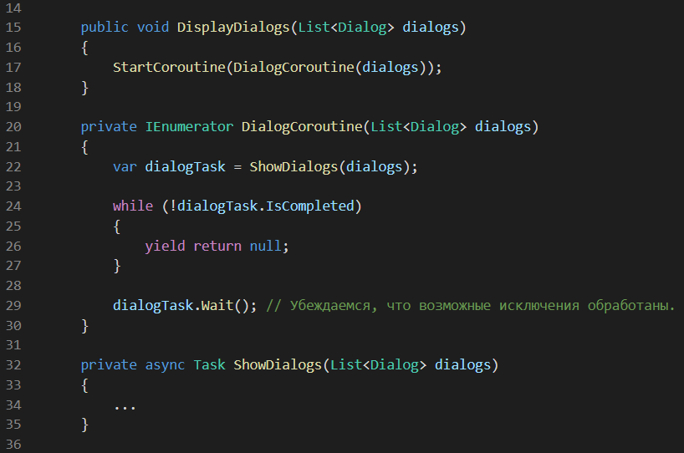
Мало полезного материала на эту тему

Slide 8
Какие на сегодня цели?
Понять основные отличия coroutines от async
Научиться правильно использовать async/await
Показать на практике как это можно применять
Убедить Вас, что не так страшен чёрт, как его малюют

Slide 9
UniTask
Основан на struct
Позволяет применять await ко всем AsyncOperations и Coroutines
Не использует потоки и работает на Unity's PlayerLoop, следовательно работает на WebGL
Совместим с Task / ValueTask / IValueTaskSource
Имеет практически такой же API как и Task

Slide 10
Coroutine | Async / UniTask
Doesn’t have return value | Has return value
Doesn’t support try/catch | Supports try/catch
Doesn’t preserve call stack | Preserves call stack
Doesn’t always exit | Always exits
Lifetime tied to a MonoBehaviour | Lifetime handled manually

Slide 11
Coroutine | Async / UniTask
Doesn’t have return value | Has return value
Doesn’t support try/catch | Supports try/catch
Doesn’t preserve call stack | Preserves call stack
Doesn’t always exit | Always exits
Lifetime tied to a MonoBehaviour | Lifetime handled manually

Slide 12
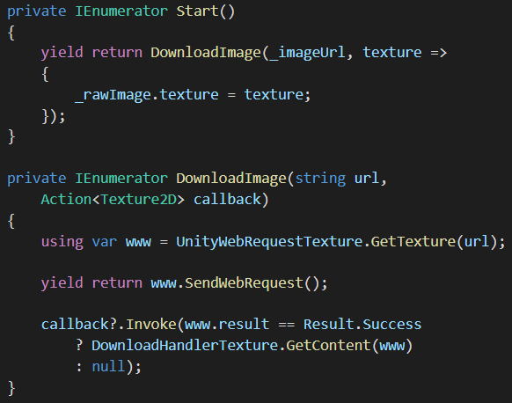
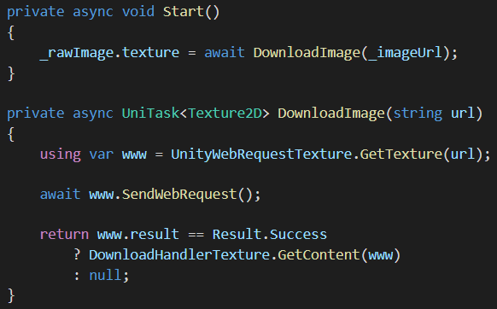
Coroutine Doesn’t have return value | Async / UniTask Has return value
* These examples are not production quality. Do not copy them into your product!

Slide 13
Coroutine | Async / UniTask
Doesn’t have return value | Has return value
Doesn’t support try/catch | Supports try/catch
Doesn’t preserve call stack | Preserves call stack
Doesn’t always exit | Always exits
Lifetime tied to a MonoBehaviour | Lifetime handled manually

Slide 14
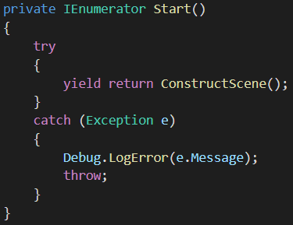
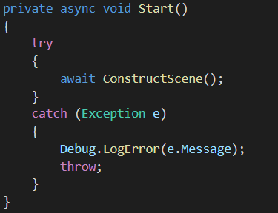
Coroutine Doesn’t support try/catch | Async / UniTask Supports try/catch
Compiler error!
Works!
* These examples are not production quality. Do not copy them into your product!

Slide 15
Coroutine | Async / UniTask
Doesn’t have return value | Has return value
Doesn’t support try/catch | Supports try/catch
Doesn’t preserve call stack | Preserves call stack
Doesn’t always exit | Always exits
Lifetime tied to a MonoBehaviour | Lifetime handled manually

Slide 16
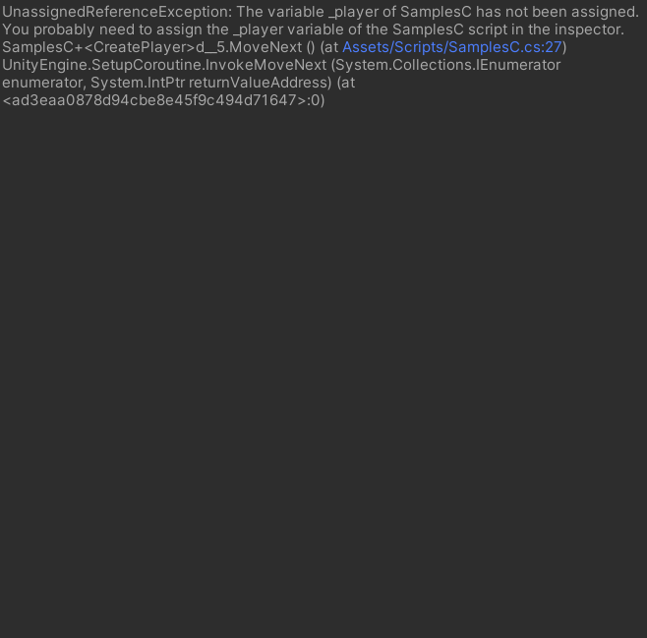
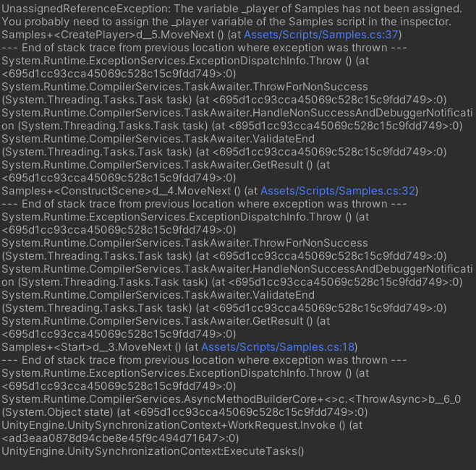
Coroutine Doesn’t preserve call stack | Async / UniTask Preserves call stack

Slide 17
Coroutine Doesn’t preserve call stack | Async / UniTask Preserves call stack

Slide 18
Coroutine Doesn’t preserve call stack | Async / UniTask Preserves call stack

Slide 19
Coroutine | Async / UniTask
Doesn’t have return value | Has return value
Doesn’t support try/catch | Supports try/catch
Doesn’t preserve call stack | Preserves call stack
Doesn’t always exit | Always exits
Lifetime tied to a MonoBehaviour | Lifetime handled manually

Slide 20
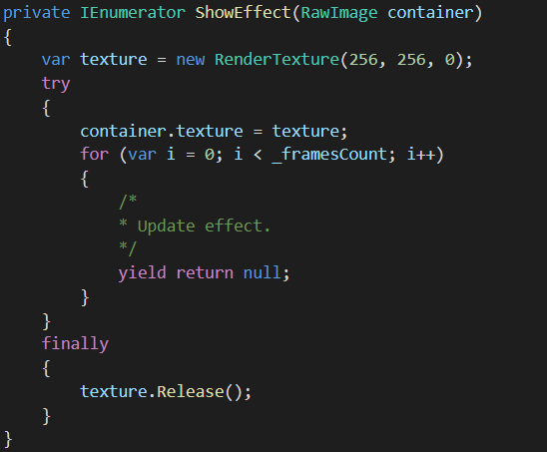
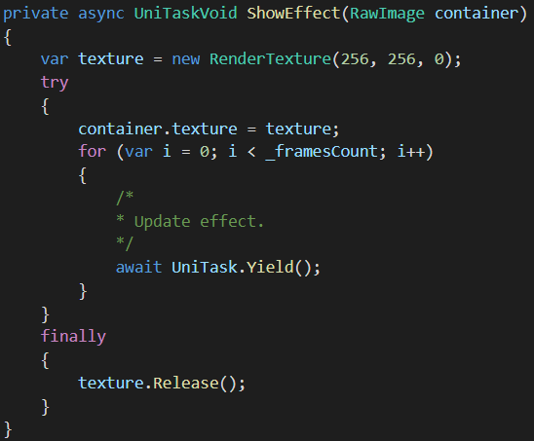
Coroutine Doesn’t always exit | Async / UniTask Always exits
Leaks if owning
MonoBehaviour is destroyed!
Never leaks!
* These examples are not production quality. Do not copy them into your product!

Slide 21
Coroutine | Async / UniTask
Doesn’t have return value | Has return value
Doesn’t support try/catch | Supports try/catch
Doesn’t preserve call stack | Preserves call stack
Doesn’t always exit | Always exits
Lifetime tied to a MonoBehaviour | Lifetime handled manually

Slide 22
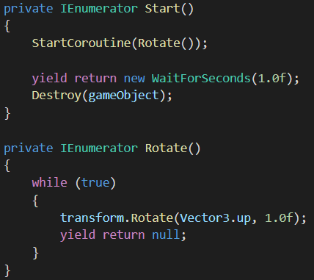
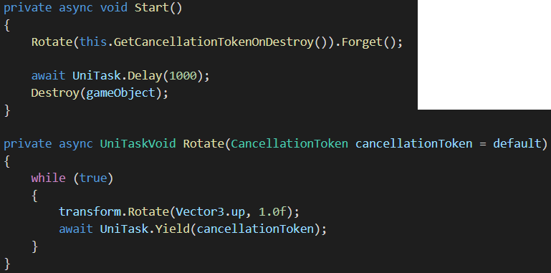
Coroutine Lifetime tied to a MonoBehaviour | Async / UniTask Lifetime handled manually
* These examples are not production quality. Do not copy them into your product!

Slide 23
Live Coding...
Параллельная загрузка и показ изображений
Последовательная загрузка и показ изображений
Загрузка и показ изображений по готовности

Slide 24
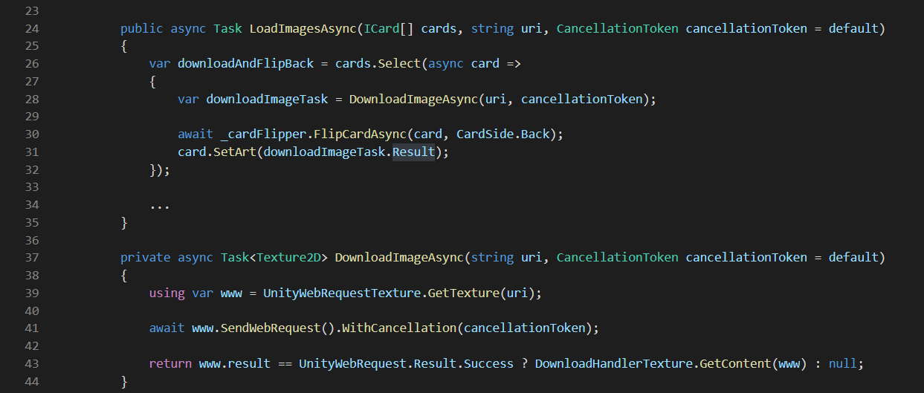
Deadlock

Slide 25
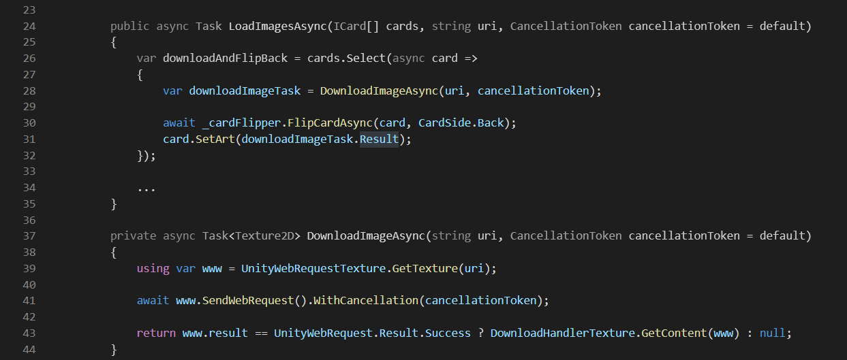
Deadlock

Slide 26
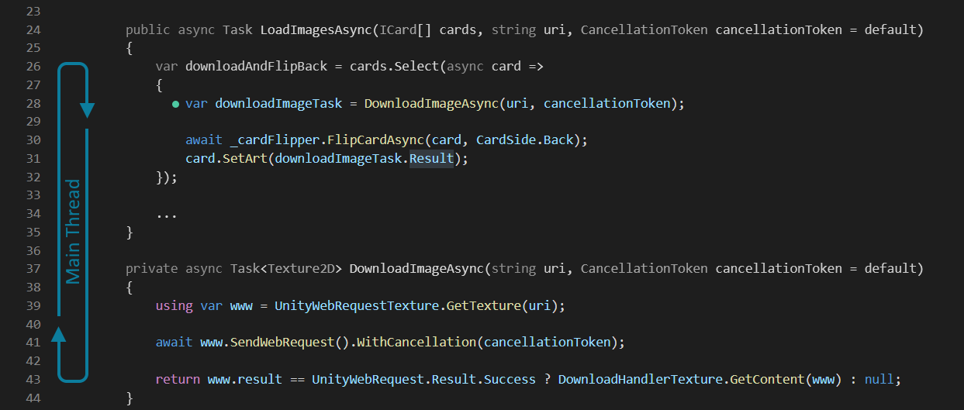
Deadlock

Slide 27
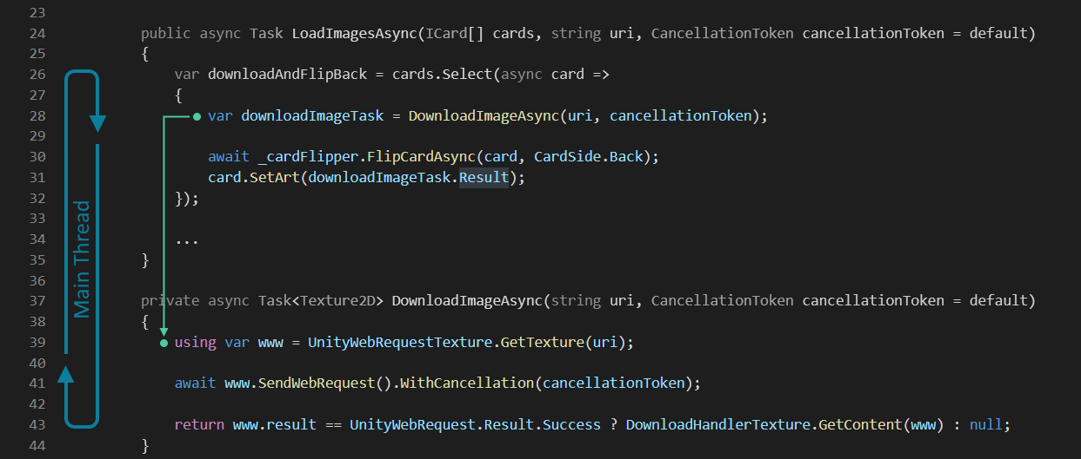
Deadlock

Slide 28
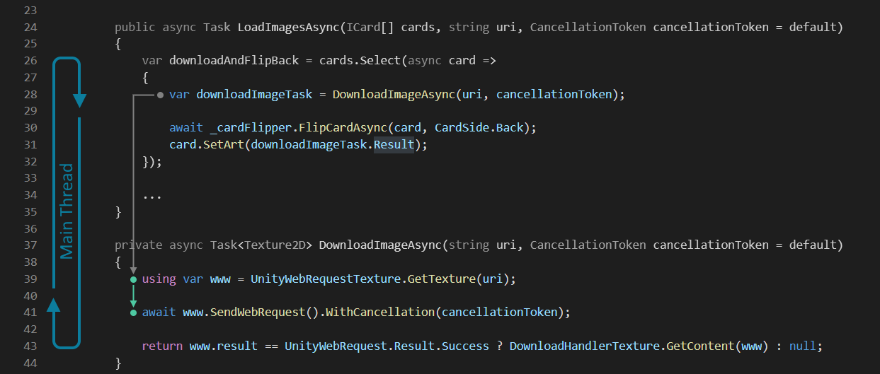
Deadlock

Slide 29
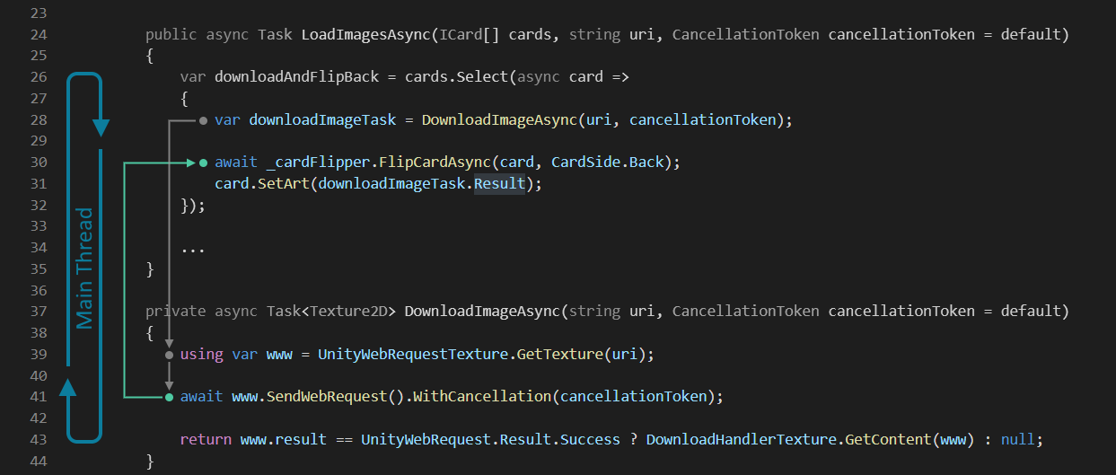
Deadlock

Slide 30
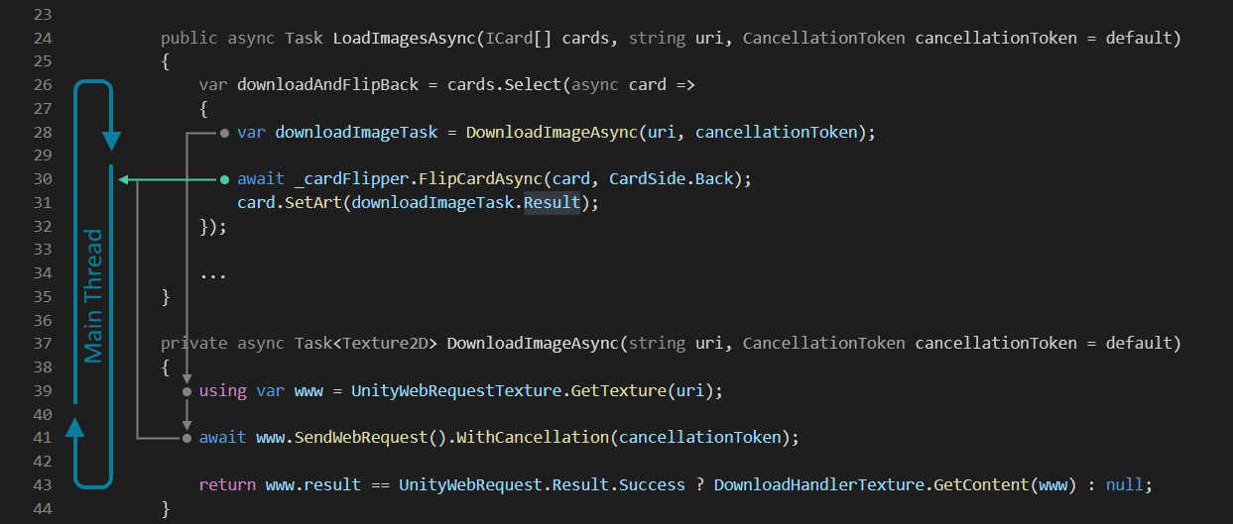
Deadlock

Slide 31
Deadlock

Slide 32
Deadlock

Slide 33
Deadlock

Slide 34
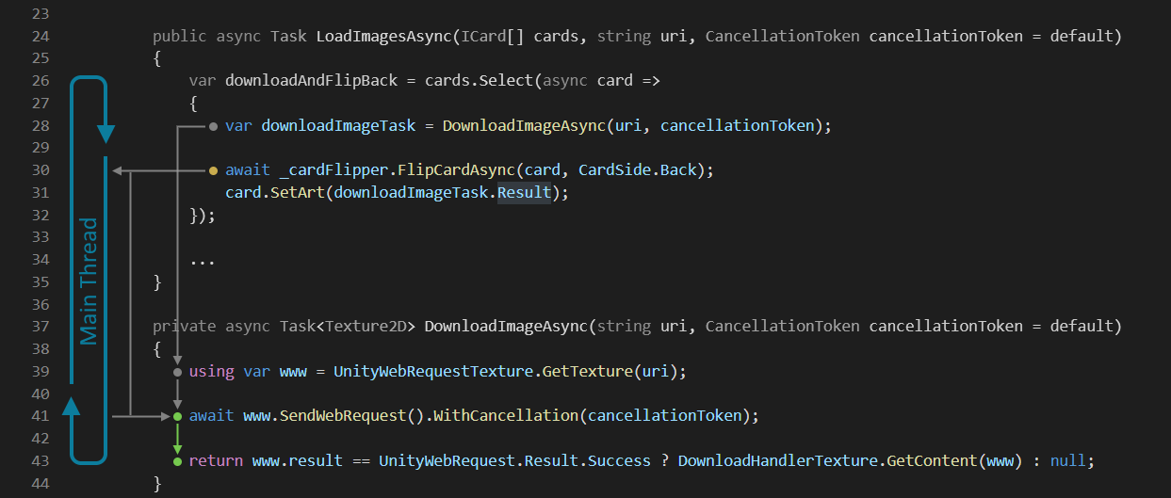
Deadlock

Slide 35
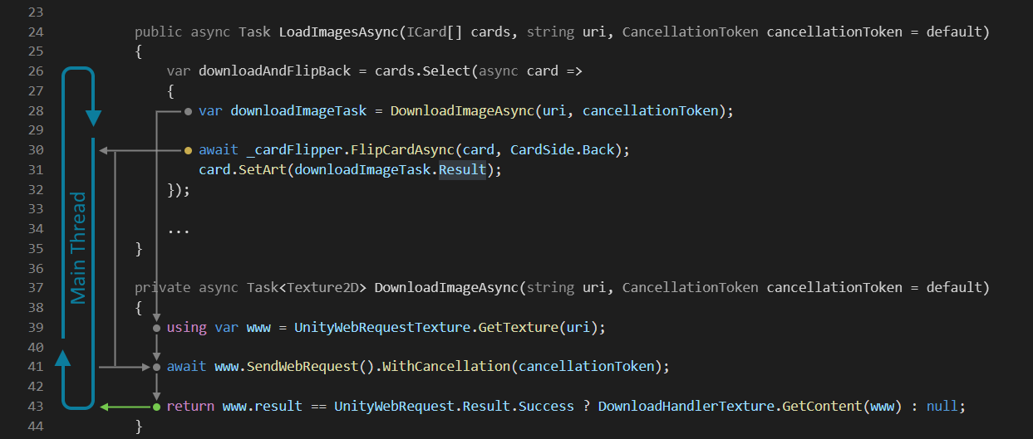
Deadlock

Slide 36
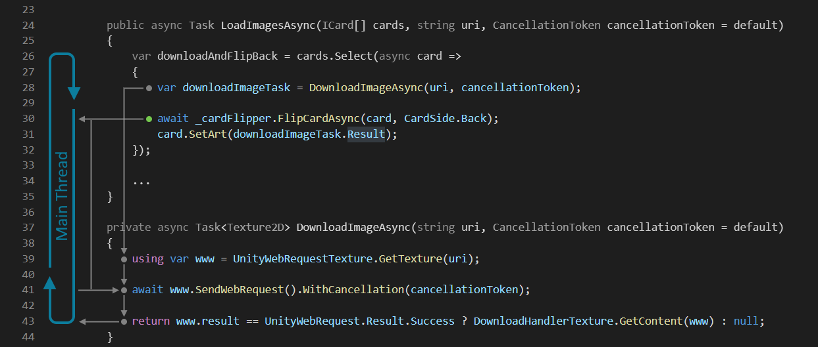
Deadlock

Slide 37
Deadlock

Slide 38
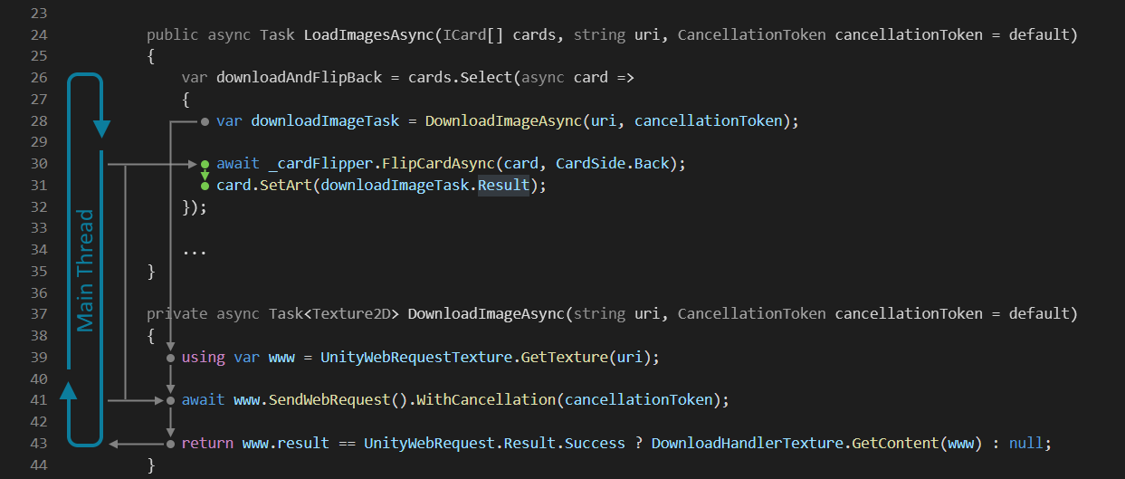
Deadlock

Slide 39
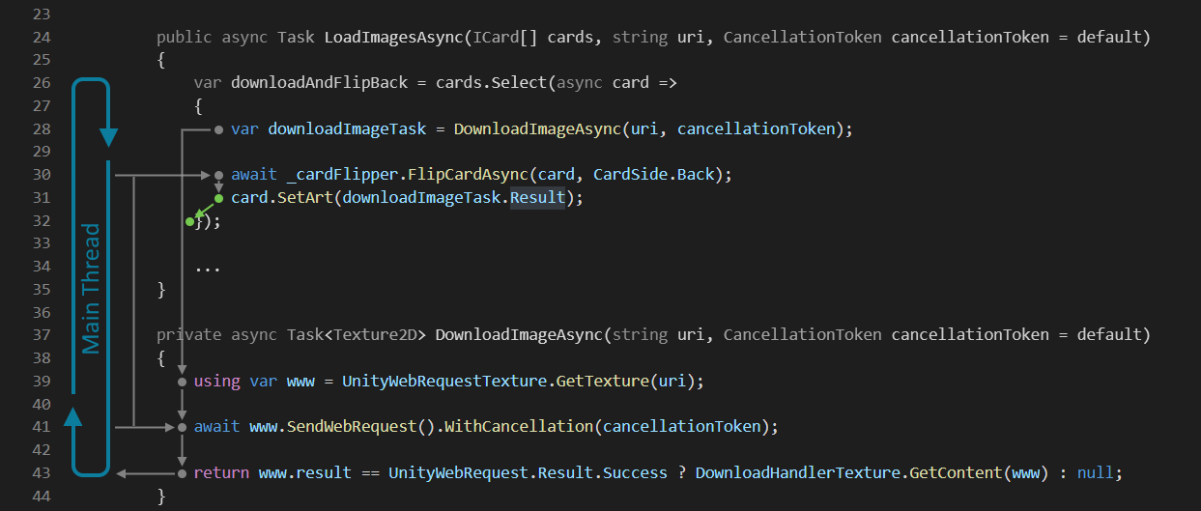
Deadlock

Slide 40
Deadlock

Slide 41
Deadlock

Slide 42
Deadlock

Slide 43
Deadlock

Slide 44
Deadlock

Slide 45
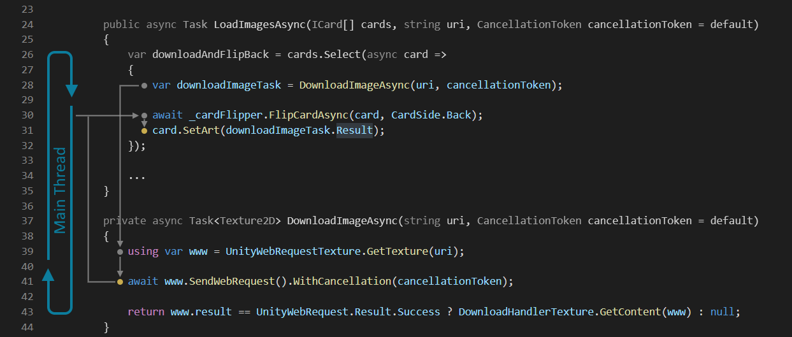
Deadlock

Slide 46
Deadlock

Slide 47
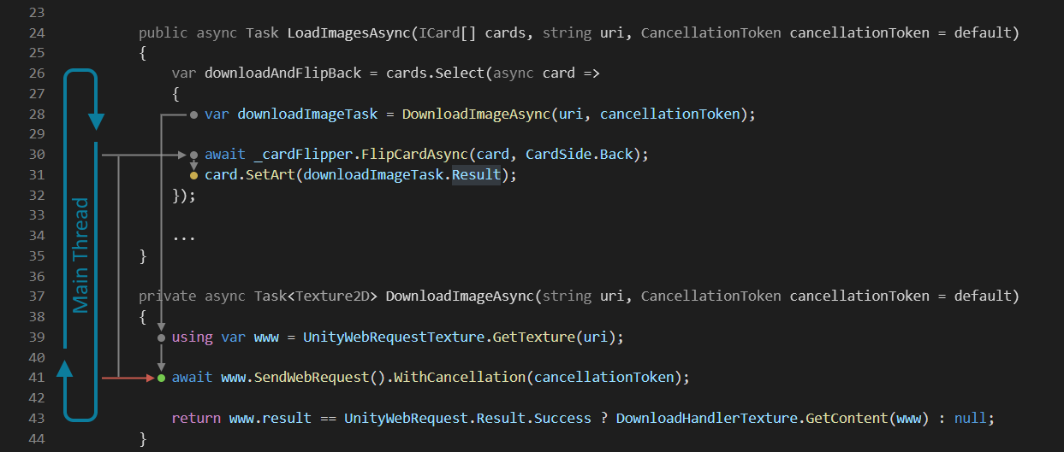
Deadlock

Slide 48
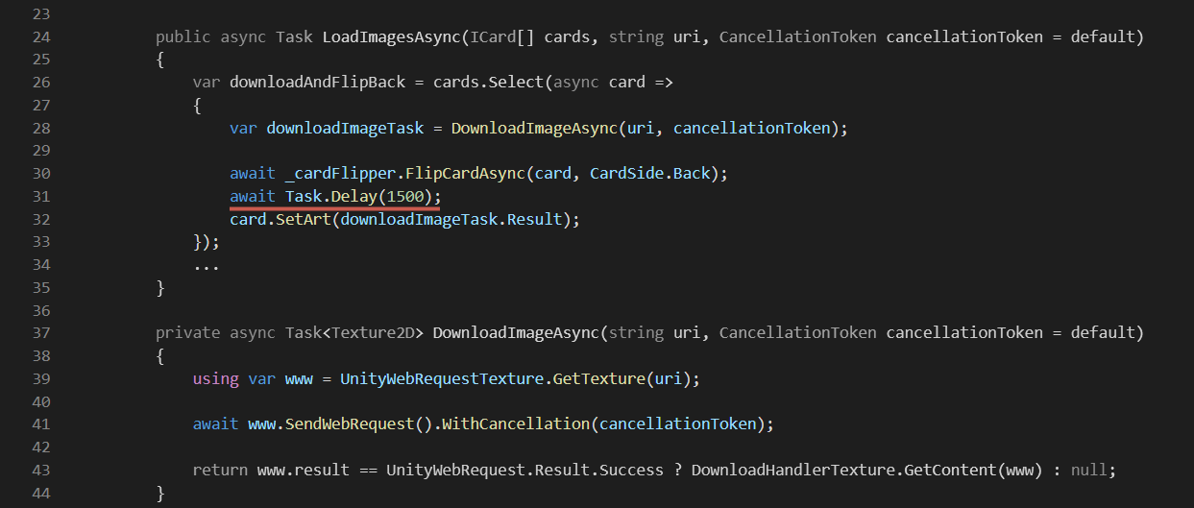
Deadlock

Slide 49
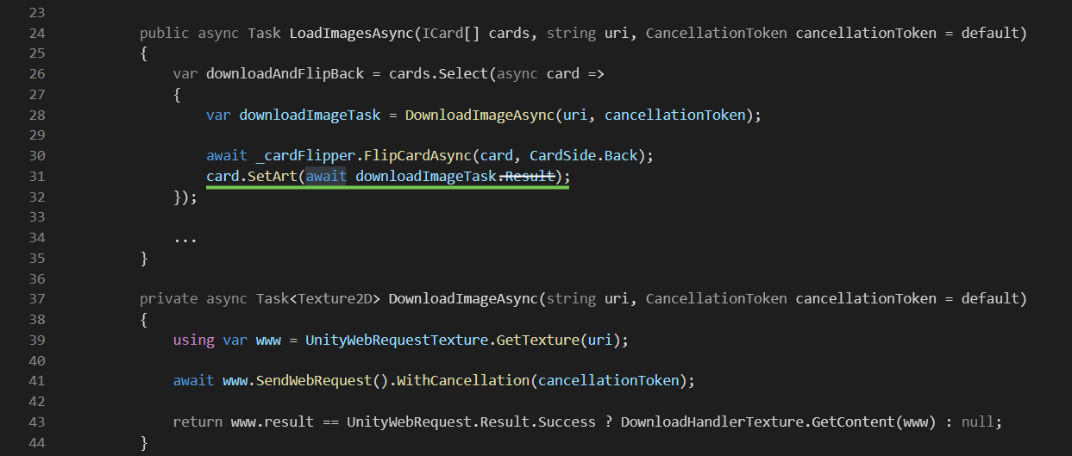
Deadlock

Slide 50
Как исправить первый пример?

Slide 51
Как исправить первый пример?

Slide 52
Как исправить первый пример?

Slide 53
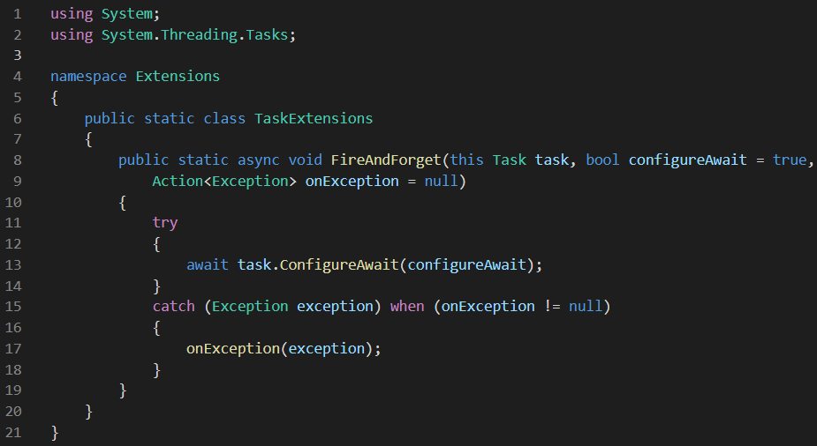
Как исправить первый пример?

Slide 54
Итого
Нет .Result и .Wait
Избегайте async void
Используйте CancelationToken

Slide 55
Итого
Нет .Result и .Wait
Избегайте async void
Используйте CancelationToken
Не используйте Coroutine для управления Task

Slide 56
Материалы
Async vs Coroutines – Unite Copenhagen
8 await/async mistakes that you SHOULD avoid in .NET
Correcting Common Async/Await Mistakes in .NET
Best Practices for Using Async and Await
Async and Await, All the Things Your Mother Never Told You
AsyncGuidance

Slide 57
Спасибо за внимание!
Dmitriy Chebanov
LinkedIn
dima-chebanov
Telegram
DmitrySx
GitHub
ChebanovDD

